Slide 1


SOMERSET PURPOSE
Somerset Academy, Inc. promotes a transformational culture that maximizes student achievement and the development of accountable, global learners in a safe and enriching environment that fosters high-quality education.
S - Set high expectations
O - Objective
M - Meaningful curriculum
E - Effective
R - Resourceful and responsible life long learners
S - Scholars who achieve proficiency and beyond
E - Evaluate continuously and use data to drive curriculum
T - Teachers who are highly qualified

Slide 2

DO NOT. . .
“Hang out” in the stairwells or on the second floor during lunch.
Chew gum. DO NOT BRING GUM!
Go on the basketball court with a skateboard!
Use the elevator without approval from the office.
Leave campus if you are a Middle Schooler, Freshman or Sophomore (Except for DE students)
Allow an underclassmen in your vehicle without prior permission, or you will lose all privileges for the remainder of the school year.
Throw anything off the balcony.
Throw anything from the ground level to the 2nd floor.
Eat or carry food over the basketball court or turf field
Litter or leave garbage around at lunch
Hang out by the wavy wall side or behind the basketball court bleachers
Hang on or grab the basketball nets/rims
Playing “keep away” = a detention
Yoga pants/ leggings/ are not allowed. Not even during dress down days. Dress code violations earn detentions
You are not to go to the Deans’ office during class to argue a detention. You will be turned away.

Slide 3
Discipline
Discipline is applied with mutual respect in a firm, fair , reasonable and consistent manner.
Preventive Morning announcements, Teacher and School's Rules & Expectations
Supportive Warnings for students to get back on task. Email notification to parents
Corrective Weekly Monday Detentions, Monthly Saturday Detentions

Slide 4
Somerset College Prep Discipline Matrix
*Warnings* Do Not apply to all discipline. Teacher & Staff discretion
DETENTION
SATURDAY DETENTION
SUSPENSION including DISMISSAL
3:50 to 4:50pm
Classroom Disruption
Disruptive Conduct
Chewing Gum
Bus Violation
Disrespect for others
Disrespect for property
Littering during lunch
Electronic Confiscation
Public Display of Affection / P.D.A
Profane Obscene Abusive Language
Running in the Halls
Spray used in the Restrooms
Tardy to Class
Tardy to School ( 3 late arrivals non bus rider)
9:30 to 12:30pm
Horseplay
Missed Detention
Multiple Detentions
Disruptive Conduct
Bus Violation
Skipping = 2 Saturday Detentions, Referral & 9 week Behavior Probation Contract
Cheating = 3 Saturday Detentions, Referral & Behavior Probation Contract
Excessive Detentions / Unserved Detention
Theft
False or Misleading Info
Open Defiance of Authority
Vaping
Physical Altercation
Fighting or Attempting to Fight
Assault / Intimidation Threat of Student
Weapons
Other Major Misconduct

Slide 5
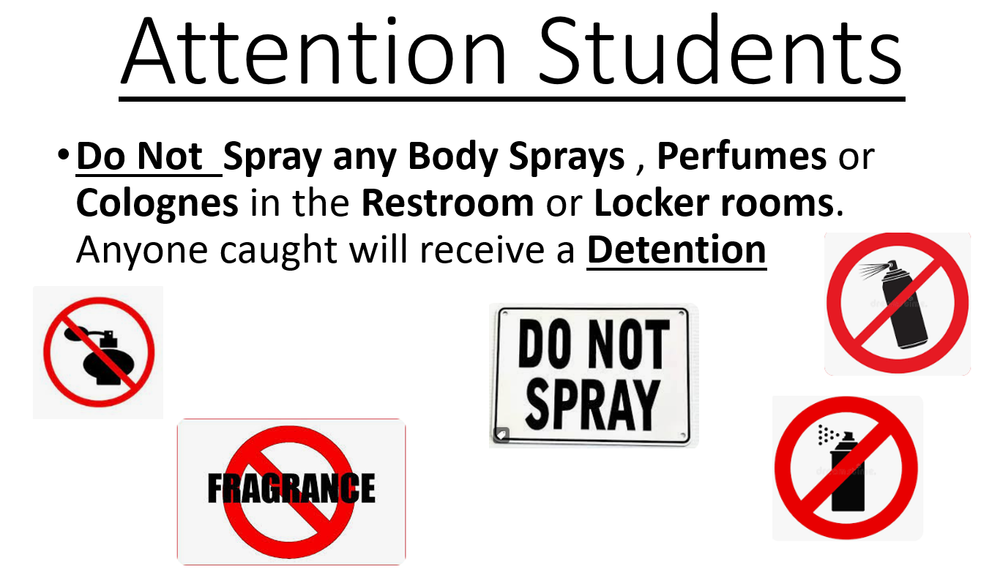

Slide 6


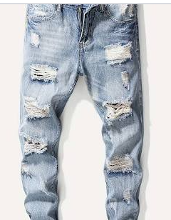
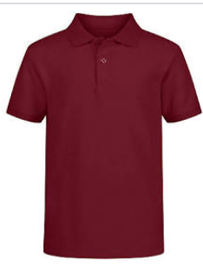
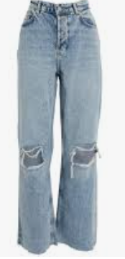
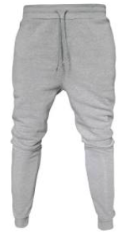
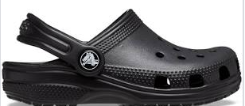

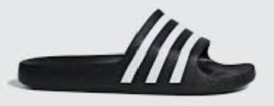
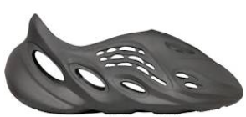
Dress Code Violations (Do Not Wear)
Ripped or Frayed Jeans
Non - Somerset, Hoodies or Polos
Crocs, Slides & Foam Runners
Sweatpants, Joggers, Yoga pants, tights or Pajama pants

Slide 7
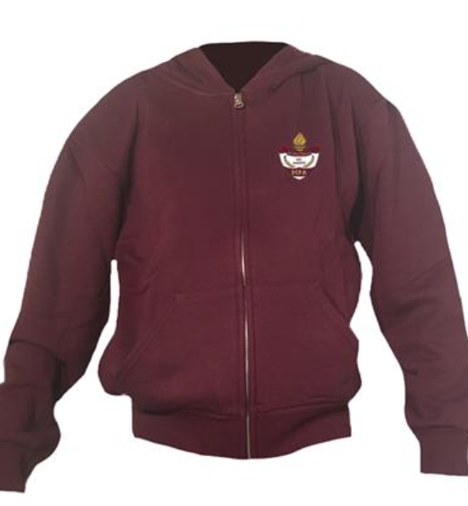
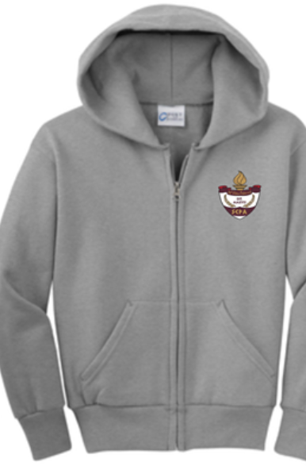
Dress Code Violations
A Somerset College Prep shirt must be worn underneath a zip up Hoodie or Jacket.
Exceptions would include
House Shirts on Thursday's
School Friday Shirts
Club Shirts
School Athletic apparel for game days.
Anyone not in compliance will be given a Dress Code Violation according to our Discipline Matrix.

Slide 8
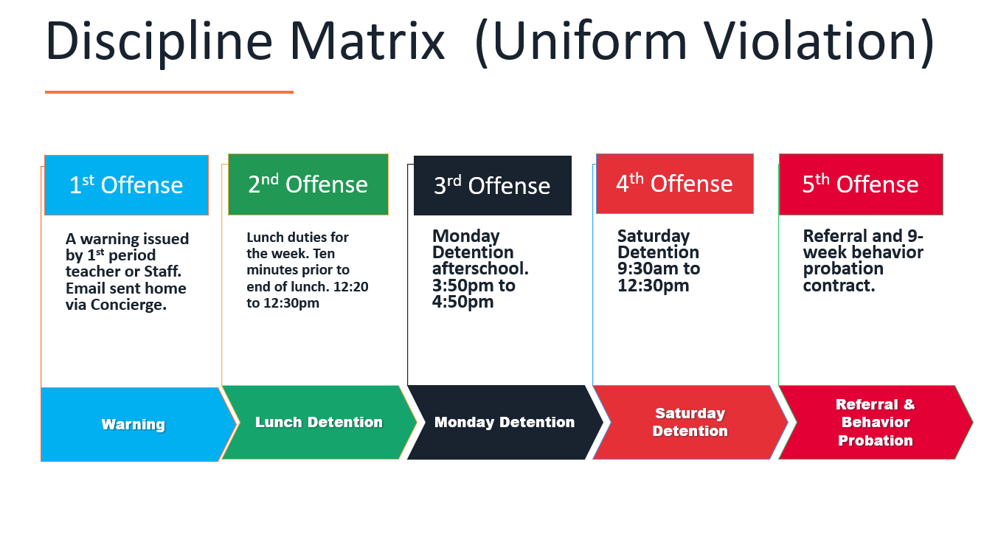

Slide 9
Dress Code (What can I wear)
School Appropriate Attire
OK
Solid Color Shorts (Fingertip length or longer)
Denim, Khaki, Cargo & Jean Shorts
House Shirts
Club Shirts
Skorts, Capris Any color
Not OK
Spandex Material
Rips , Tears or Frays
Sweatpants, Yoga pants
Tank tops
Leggings
Bottoms with print or derogatory slogans

Slide 10

Tardy—being late to class.
Being tardy to periods 2, 3, or 4 is accompanied by a detention.
Period 2, 3, 4 teachers write & submit the detention.
Being tardy to 1st period is a detention if you are a bus rider and your bus was on time.
Being tardy to 1st period and you are not a bus rider is a detention for every 3rd occurrence.
*Does not apply to excused tardies.

Slide 11
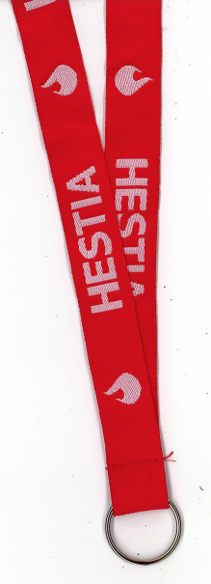
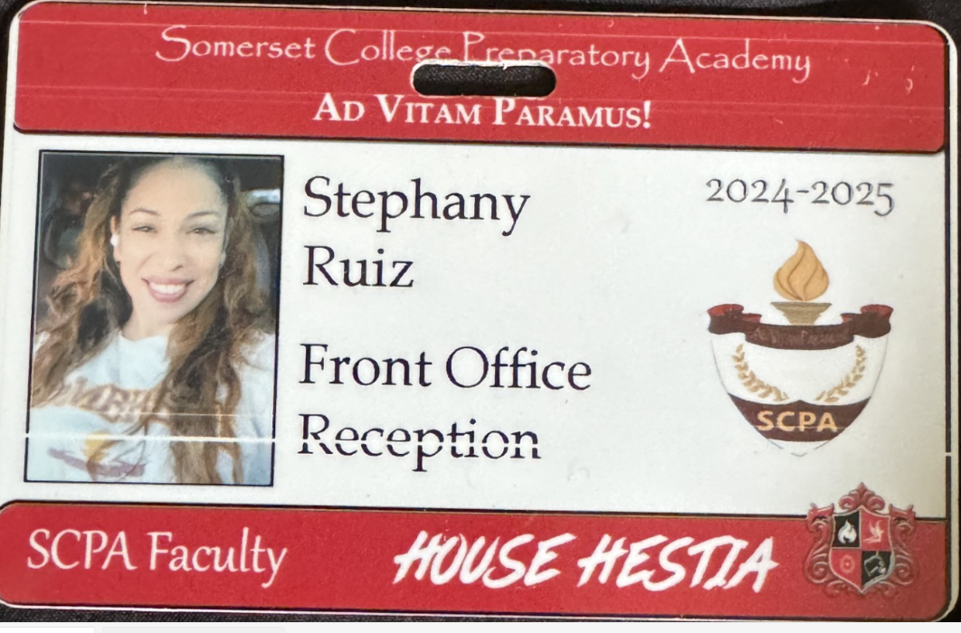
Lanyards and IDs are a Mandatory
Part of your uniform
Needs to be worn around your neck, all day/everyday during school hours
If asked, STOP and put on ID
No Lanyard and ID will result in a dress code violation.
Purchase in Front Office
Lanyard $3
ID $2 (Cash Only)

Slide 12
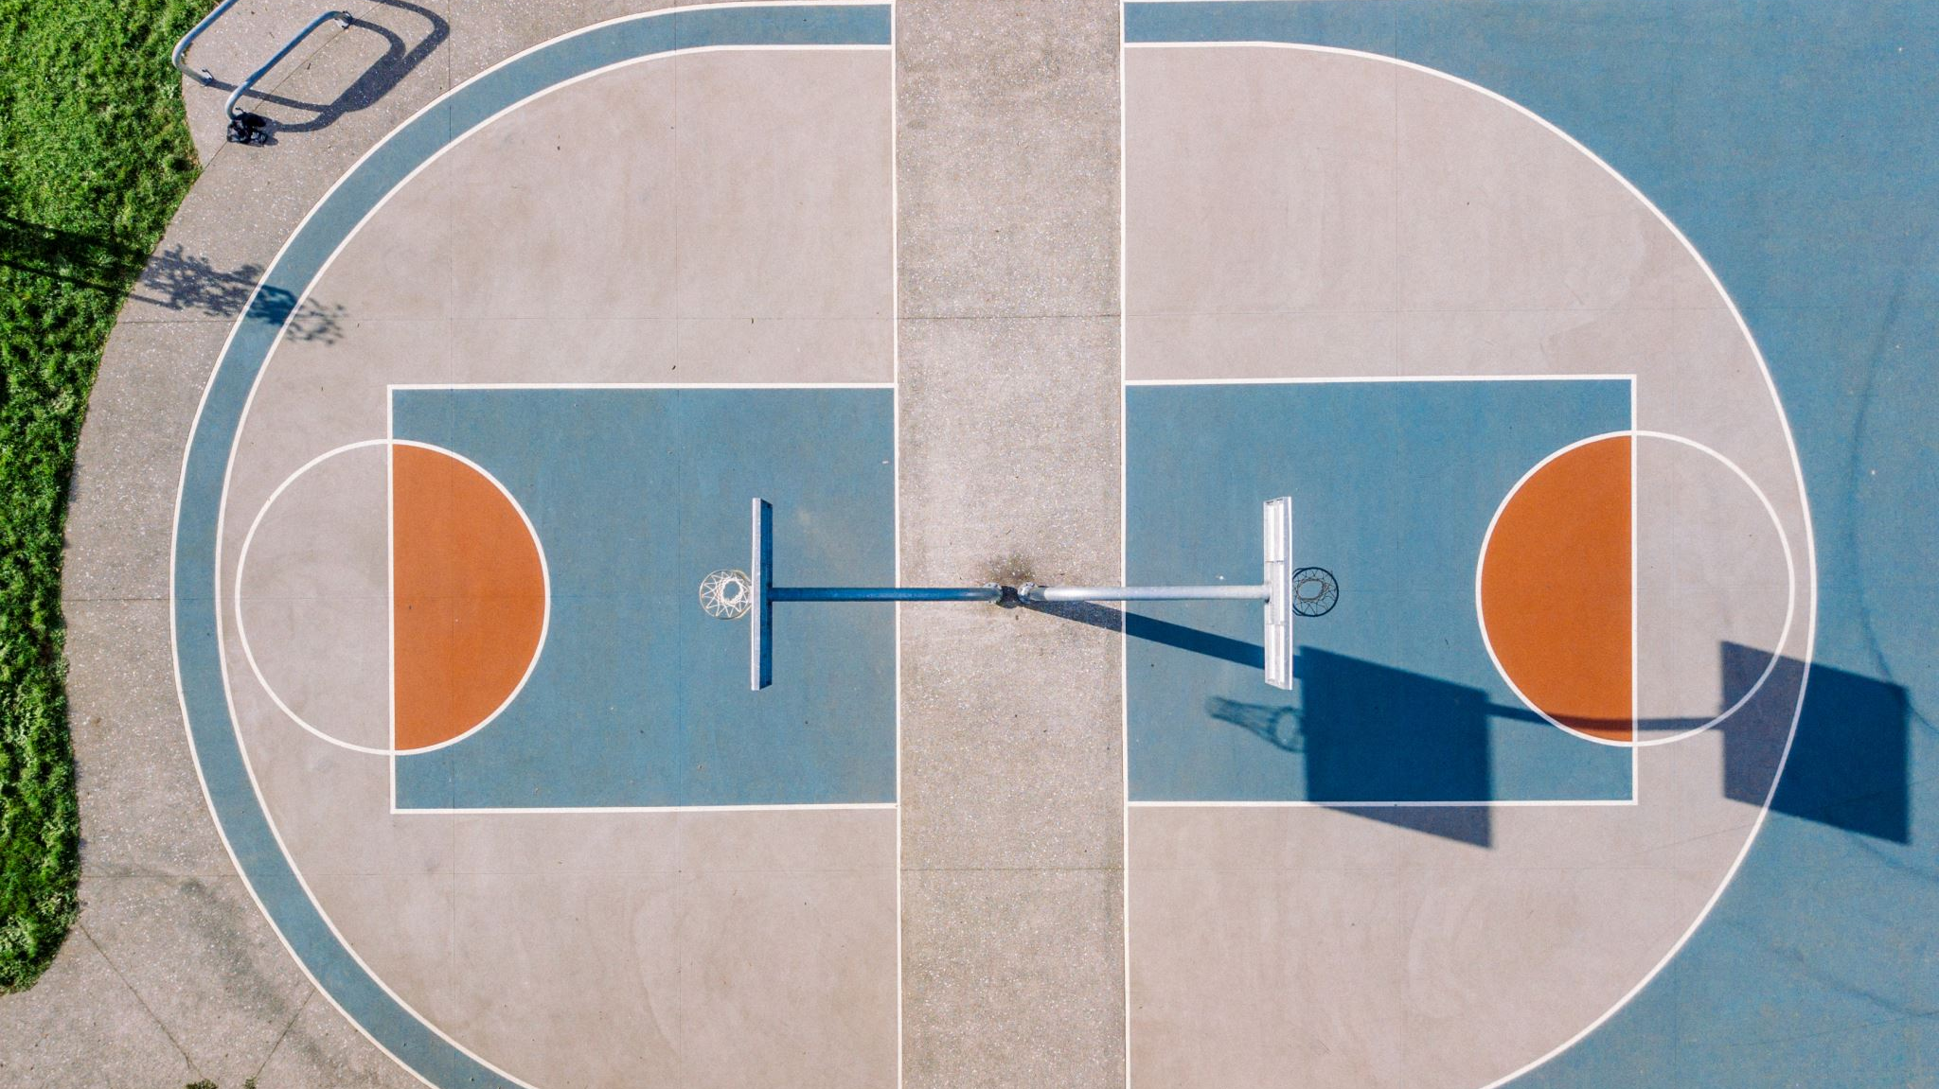
on basketball courts OR turf without a staff member present
(This means mornings & after school too.)
NO Playing ANY SPORTS

Slide 13
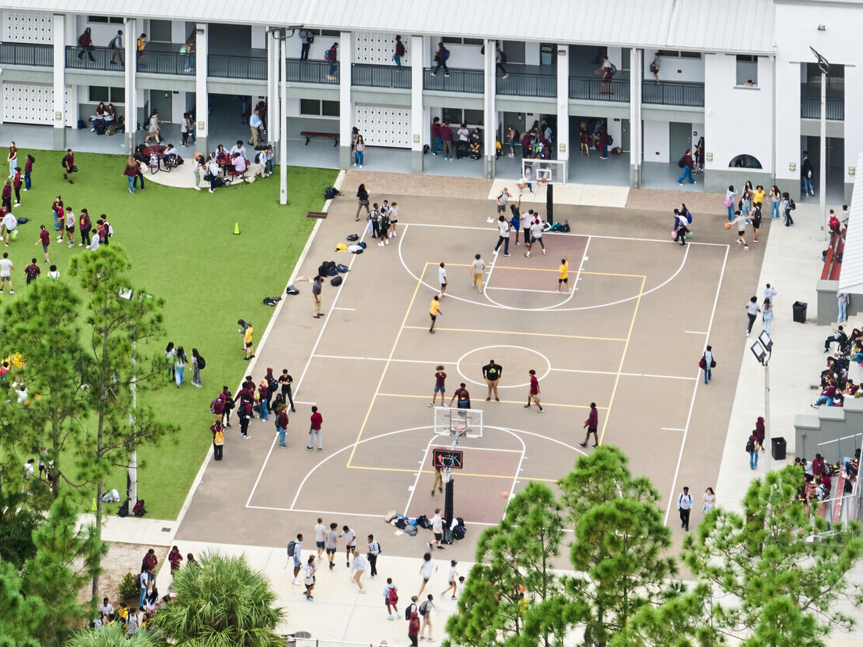
NO FOOD or drink ON THE COURT

Slide 14
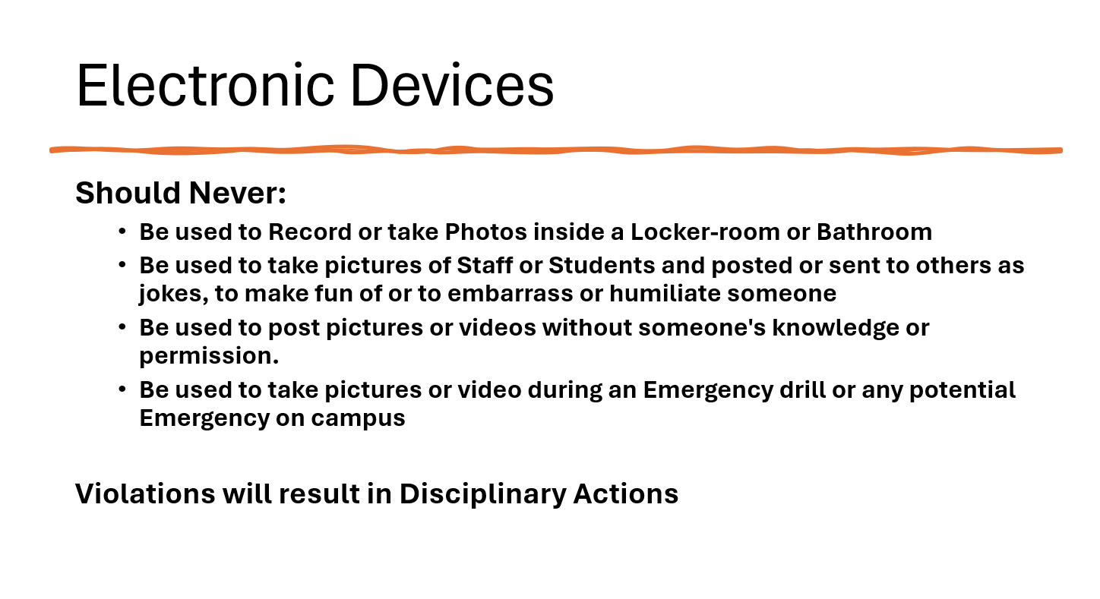

Slide 15
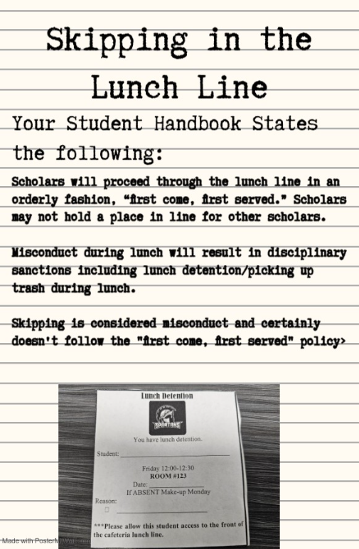

Slide 16
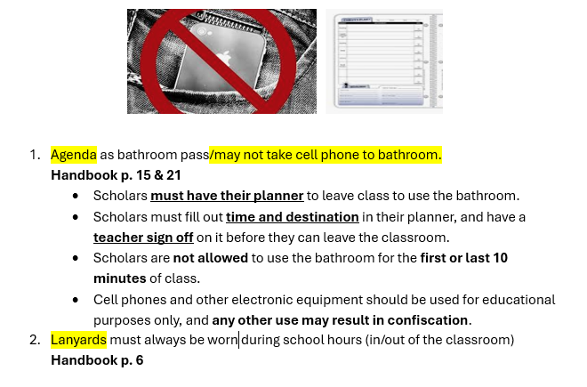

Slide 17

Tell an adult in our school!

Slide 18

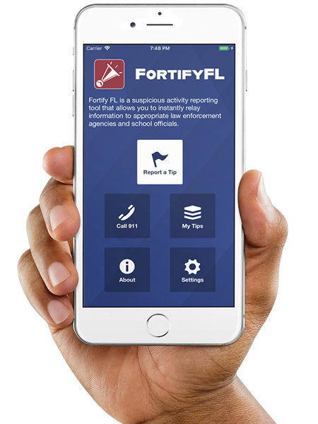
Anonymous Reporting App

Slide 19
ATTENTION STUDENTS!!
Did you know that the Florida Department of Law Enforcement and the Florida Department of Education created an anonymous reporting App that allows you to instantly send information about suspicious activity to local law enforcement and school officials?

Slide 20
WHY?
It is important to always remember that If You See Something, Say Something! With FortifyFL, you can easily submit information about potential crimes or threats which will immediately be forwarded to law enforcement and designated school personnel.

Slide 21
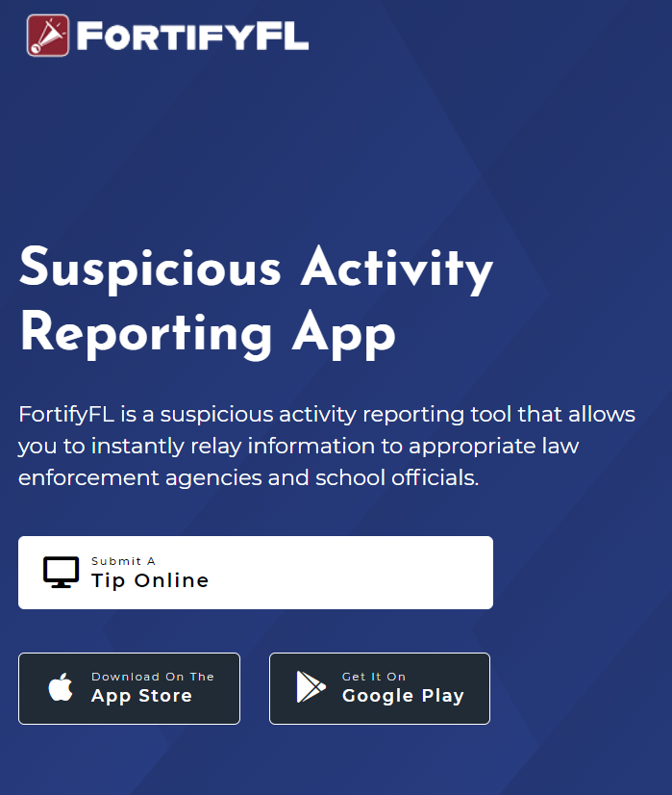
HOW DO I SUBMIT A TIP?
You can submit a tip from any computer at: https://getfortifyfl.com/

Slide 22
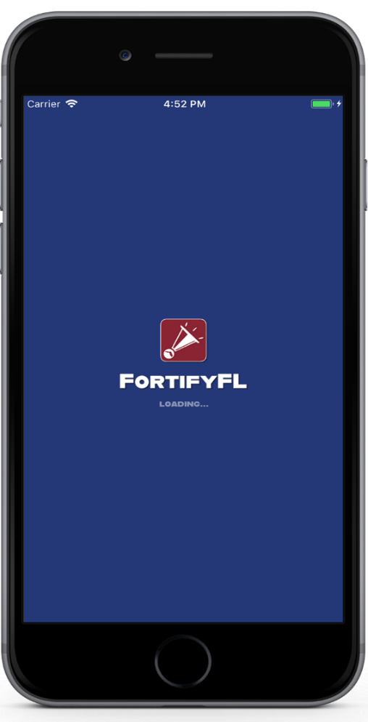

HOW DO I SUBMIT A TIP?
You can also submit a tip using your cell phone. Download the FortifyFL App on your mobile device.

Slide 23
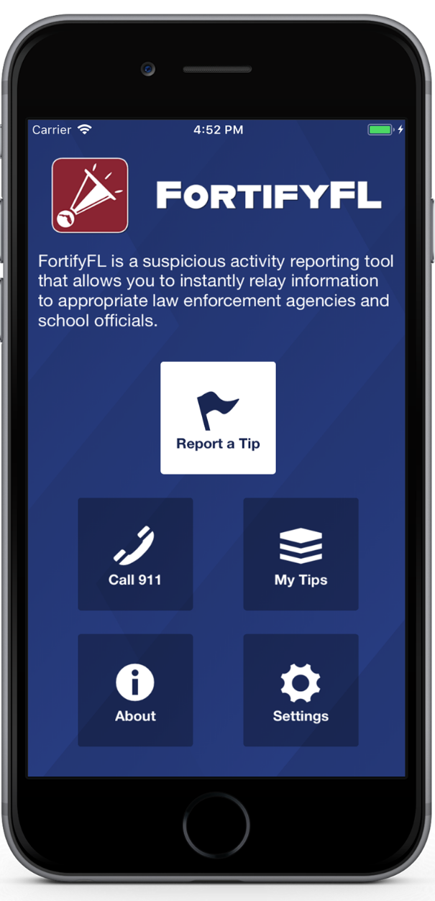
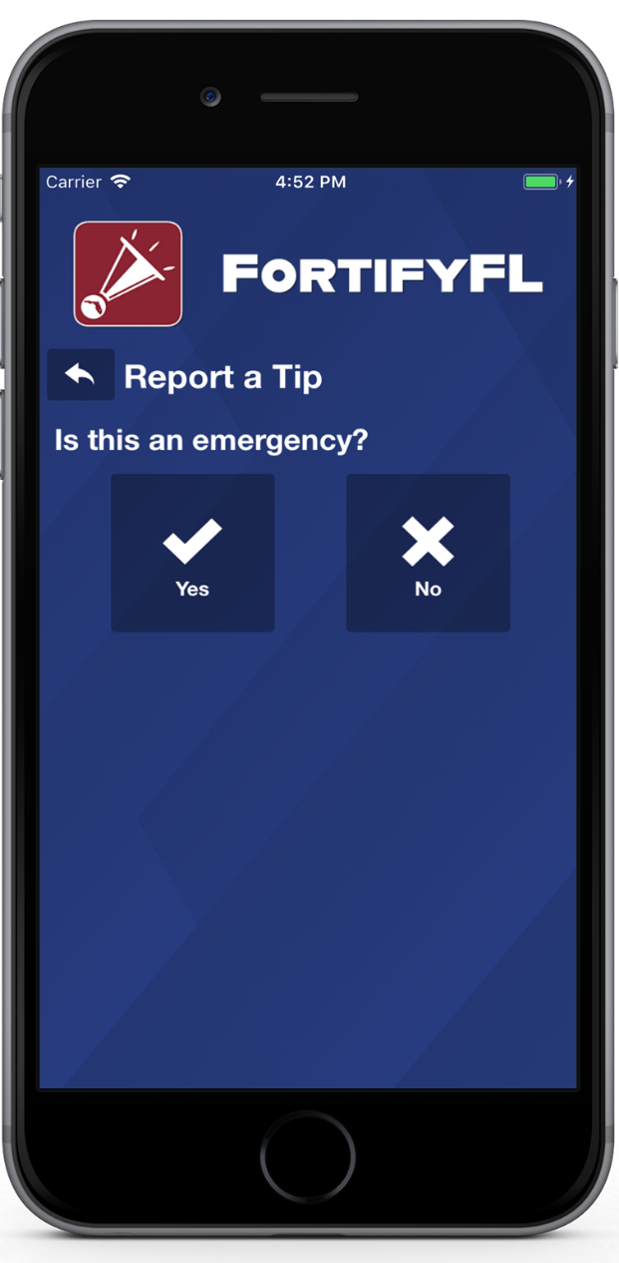
HOW DO I SUBMIT A TIP?
Click “Report a Tip,” and indicate if it is an emergency

Slide 24
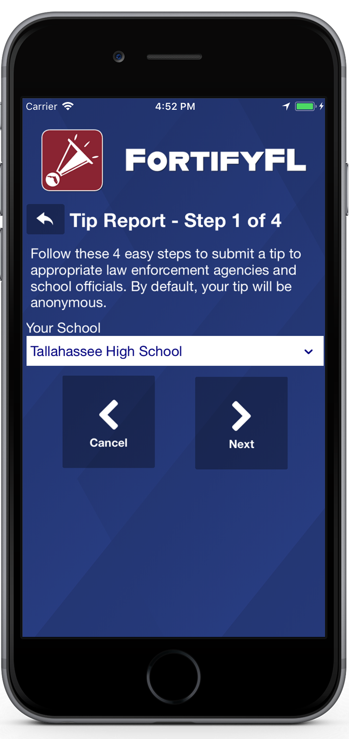
HOW DO I SUBMIT A TIP?
Step 1: Select Your School

Slide 25
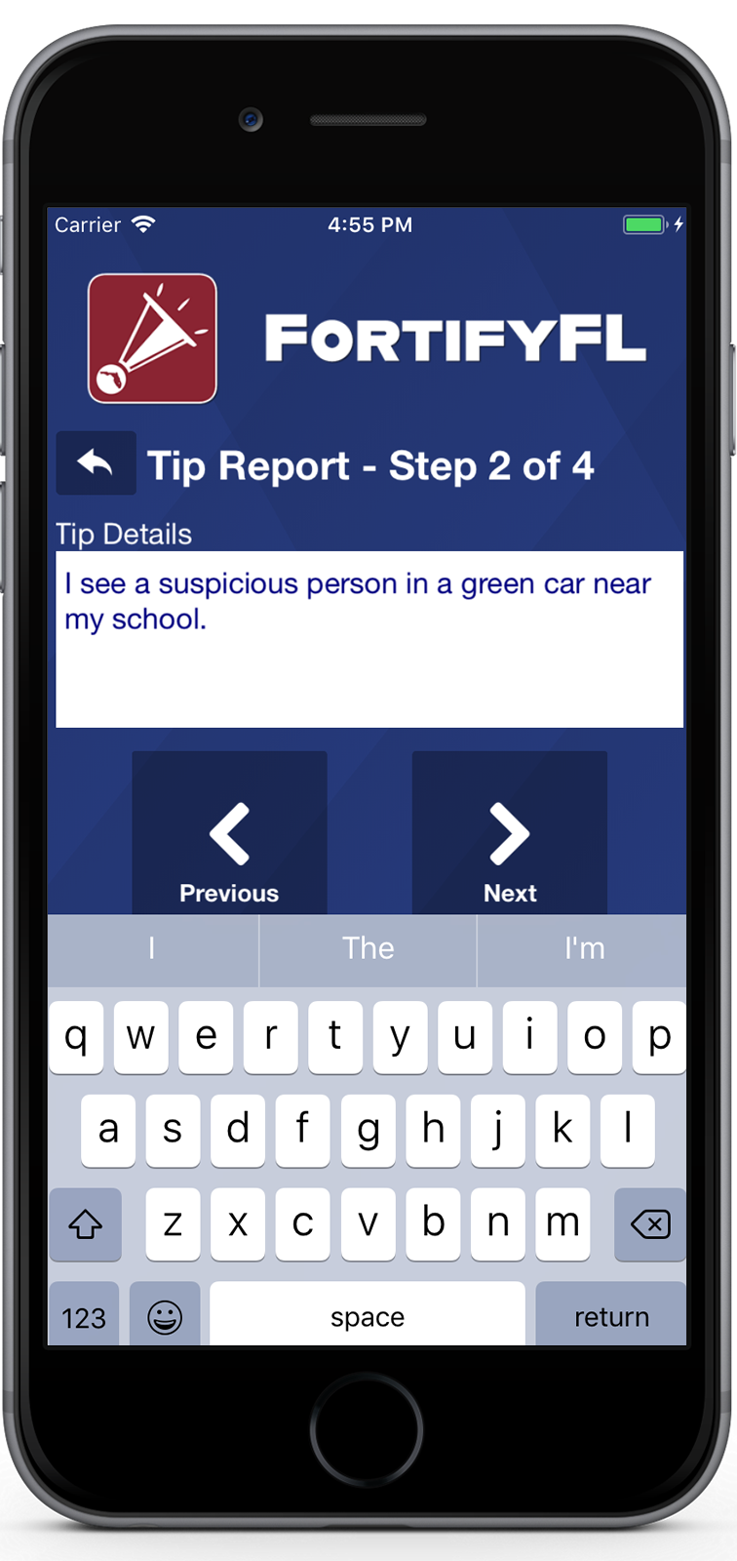
HOW DO I SUBMIT A TIP?
Step 2: Provide Your Tip

Slide 26
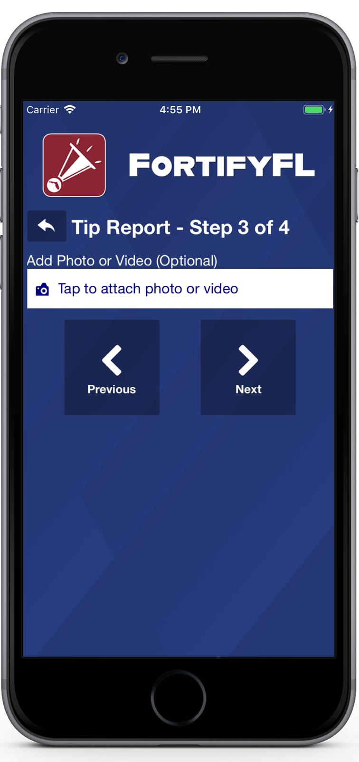
HOW DO I SUBMIT A TIP?
Step 3: Attach an Optional Photo or Video

Slide 27
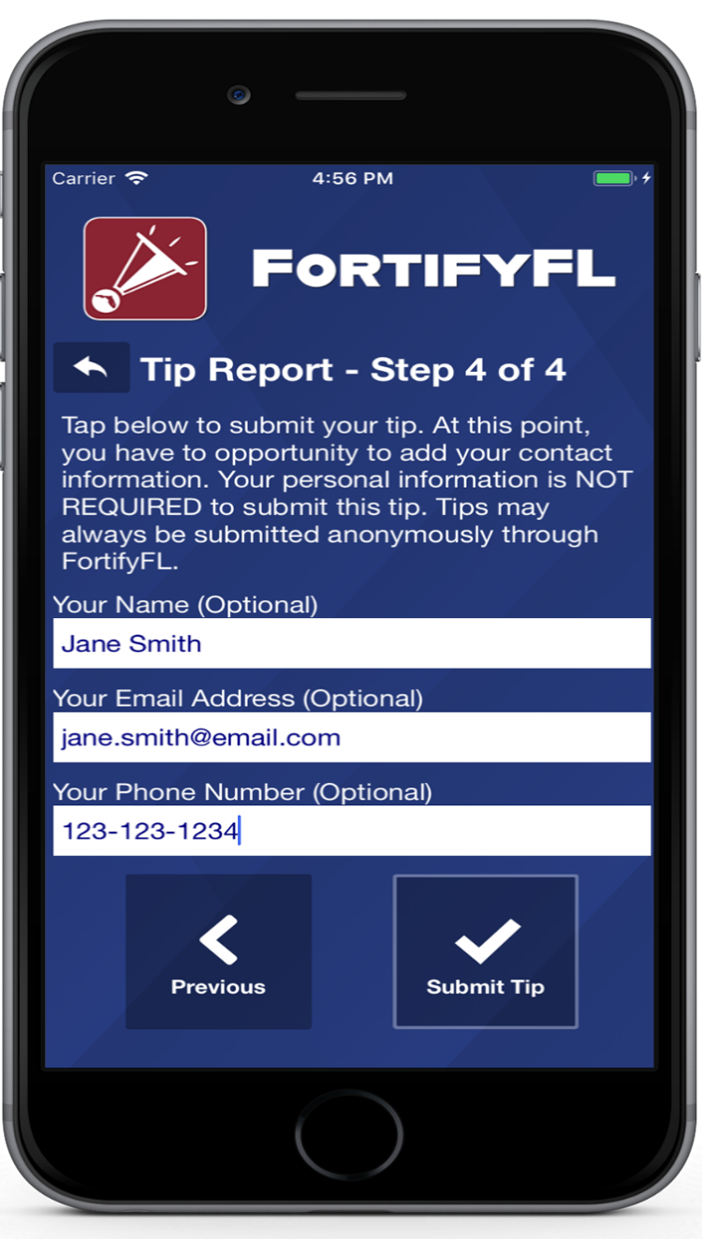
HOW DO I SUBMIT A TIP?
Step 4: Provide Optional Information and Submit Your Tip

Slide 28
False Tips Lead to possible Criminal penalties
If someone who knowingly submits a false tip through FortifyFL may be subject to further investigation by law enforcement, and may be subject to criminal penalties under Section 837.05, F.S.

Slide 29
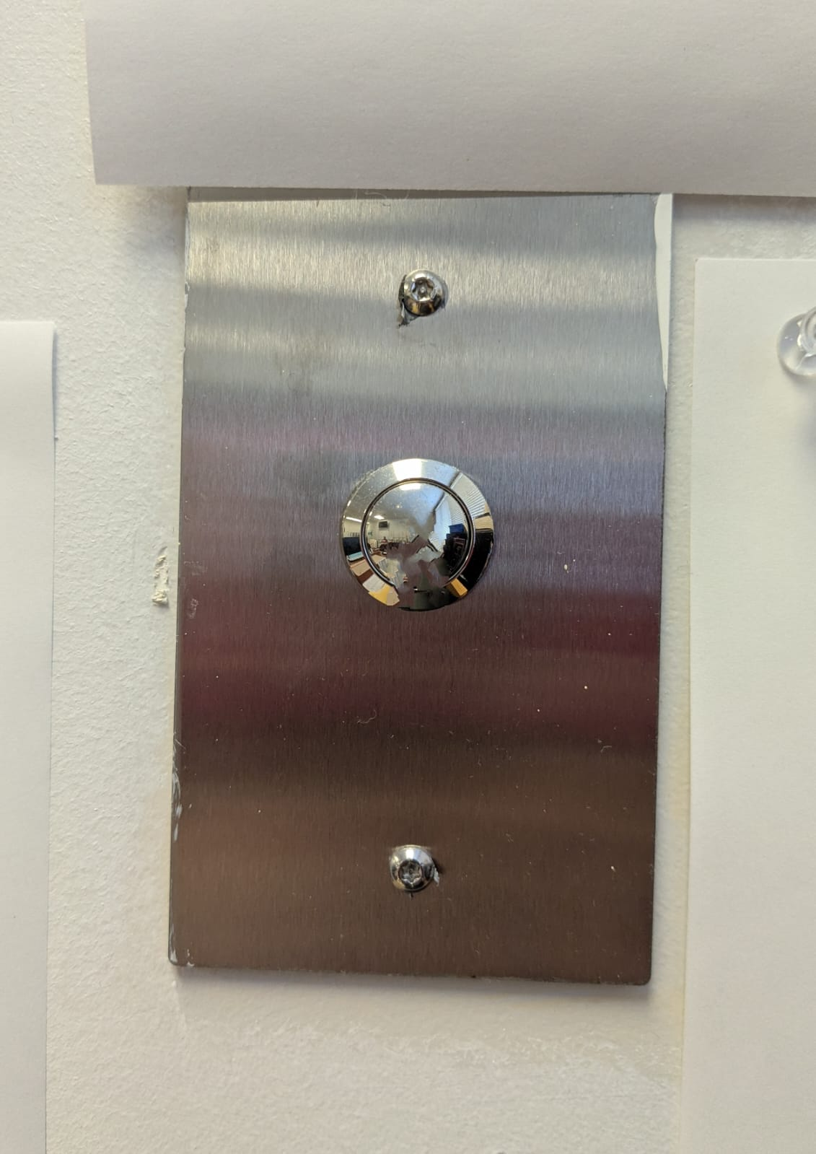

Every classroom has this button.
In the case of an emergency, push the button ONLY ONCE!
Dial 101 or 103 for front desk.
Pushing the panic button more than once cancels the call. The adults receiving the emergency won’t know where it is coming from.

Slide 30


Slide 31
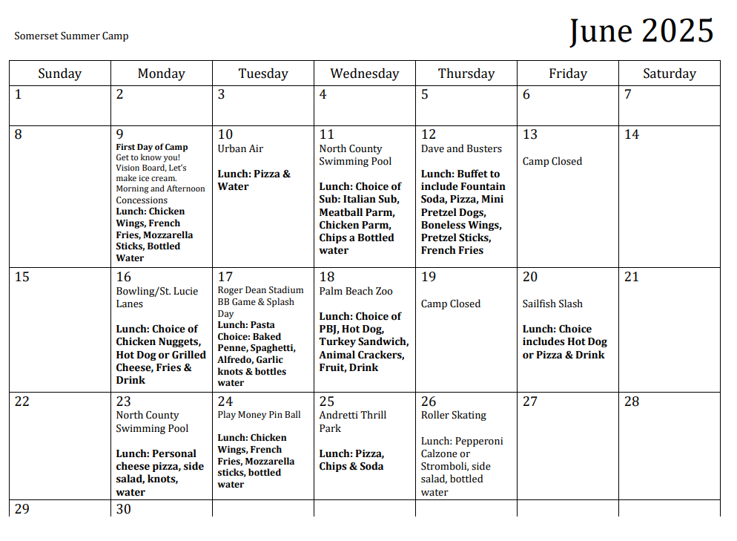

Slide 32






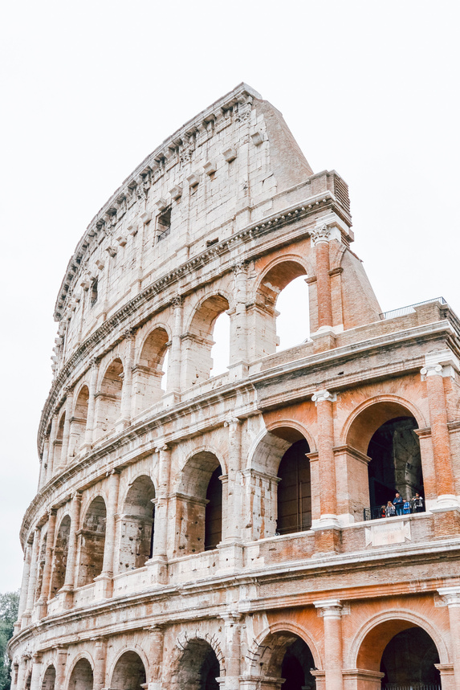









Rome
2027
Missed the Rome Meeting?
Come see Wally in Room 268 for a recap and to get a packet!

Slide 33
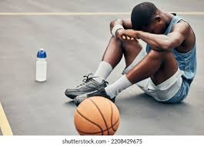
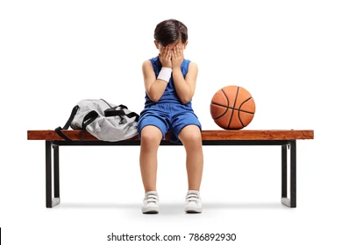
If you paid to be apart of the NBA 2K tournament that was supposed to take place during the 1st semester (but never did), please see Ms. Walker in 209 for a refund (It’s upstairs next to 205; you have to ring the door bell)

Slide 34
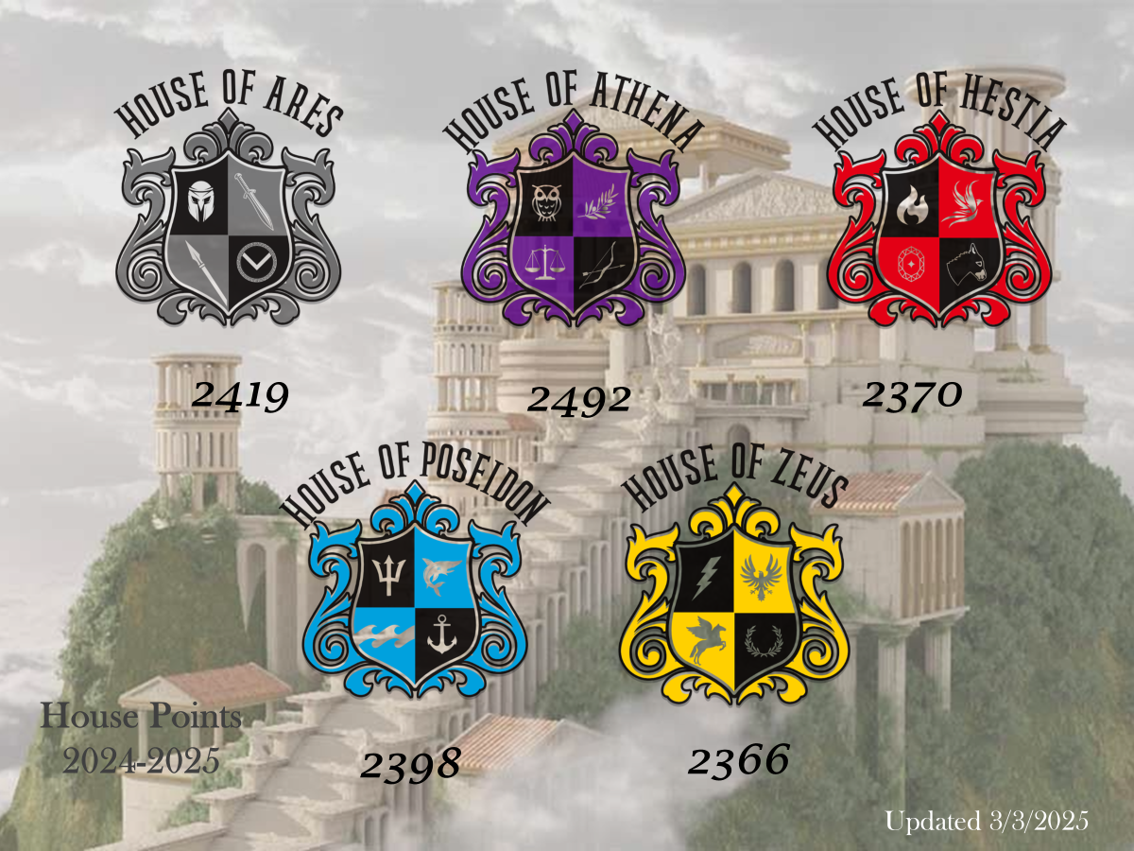

Slide 35
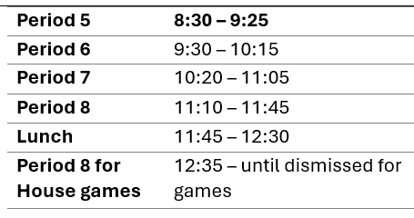
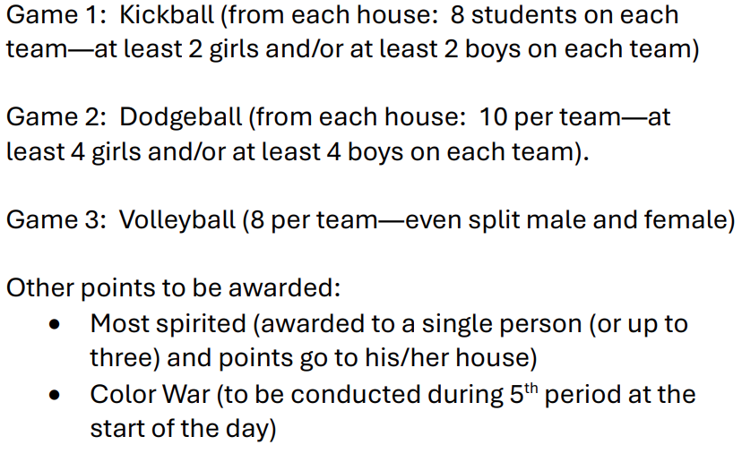
If you are interested in participating in one of the games, see your house head

Slide 36
House Games
Thursday!
Leave your backpacks at home
Poseidon Vs. Zeus Vs. Hestia Vs. Athena Vs. Ares
House Shirts or House Colors permitted—Otherwise you must be in uniform
Adjusted Bell Schedule (not early release)

Slide 37





PERMISSION FORMS MUST BE TURNED IN BY FRIDAY!!!
ATTENTION STUDENTS!
FIELD DAY IS ALMOST HERE! DON’T MISS OUT ON THE FUN!
Featuring: THE SPARTAN GAMES
  Kickball
  Dodgeball
  Red Light – Green Light
  Musical Chairs
  And More!
Date: May 30th, 9 AM - 1:30 PM
Your Ticket Includes: 2 Slices of Pizza, 1 Bottled Water, 1 Bag of Chips, 1 Kona Ice
Activities include: Activities: Inflatable Obstacle Course, Inflatable Jousting, Dunk Tank ( $1 per throw), Movie Room, and so much more!
Wristbands will be distributed on Thursday, May 29th.
You must wear your wristband on Friday to participate — don’t lose it!

Slide 38

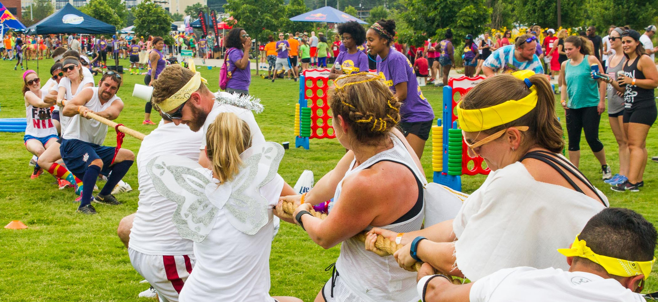
Field Day Info
Inflatables and games will be set up on the turf and spill out.
Karaoke Room 276 (Theater)
Virtual Reality Game Room 135
Movie Rooms – 127 and 129
House Room for 2025 Overall Winning House – Room 164
Pizza and Water – Room 123
Holding Room for NON-Participants – 224 and 226
Holding Rooms for Academic and Behavior Probation Students – 241, 249, and 247
Just Dance (am) – in the gym
Dodge Ball/Red Light Green Light (pm) – in the gym
Basketball – on the court
Kona Ice- Bus Loop Gate

Slide 39

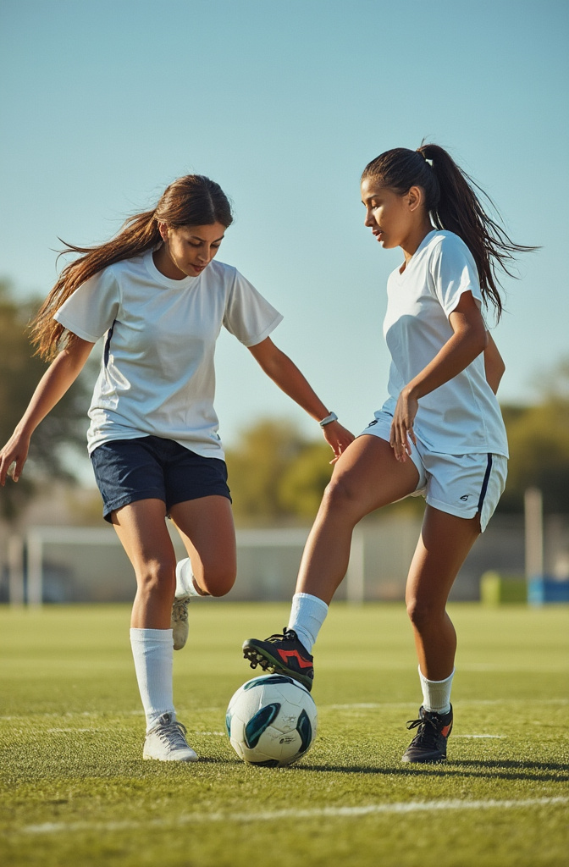
Kick Off Something Great!
💥 Wanna Join Our Girls’ Soccer Team?
⚽️ Get ready to play, grow, and have fun!
📩 Contact Coach. Batista
batista.marcos@somersetcollegeprep.org
🏫 Or stop by Room 233 during lunch!
✨ All skill levels welcome – let’s kick it together!
Dream Big. Play Hard. Join Us!
⚽👟🎯🏃‍♀️🔥🎉🌈⭐

Slide 40
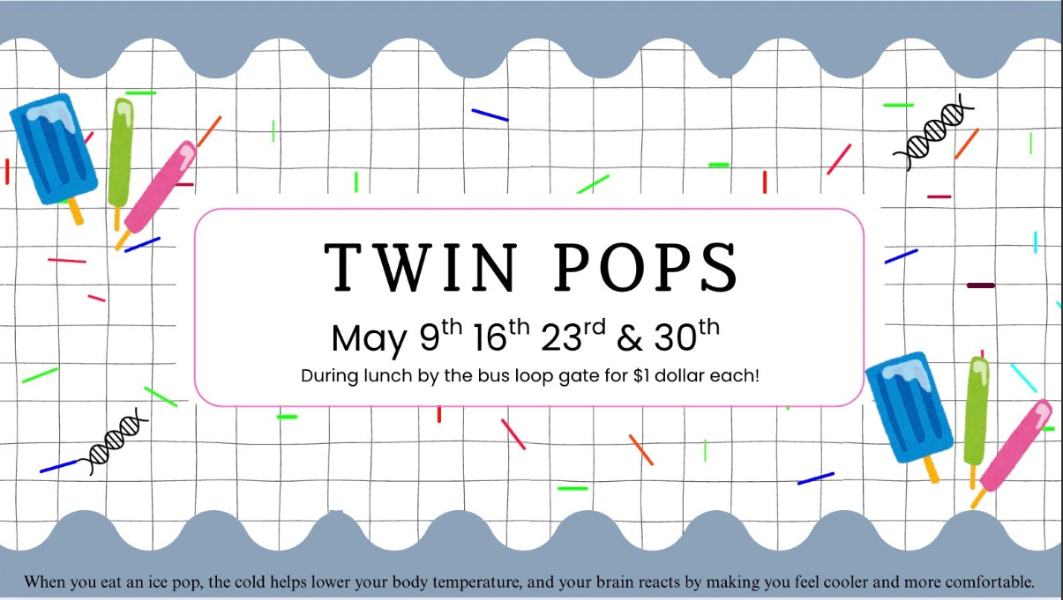

Slide 41

D&D Club
After School meetings resume
August 25, 2025
Lunch Meeting
11:50 to 12:25
August 18, 2025
Rm. #175
D&D Club wishes you all the benefits of a long rest.
Club meetings will resume after summer break.

Slide 42


Somerset College Prep &Public Wireless ACP Program
This document will also be in the front office for you to scan the QR code.

